Slide 1
Notes:
When the early Christians were being persecuted and suffered for their faith, the church grew by leaps and bounds. No matter how hard Satan pushed to destroy Christianity, it flourished amidst the most violent of opposition. At the beginning of the 4th century, however, things would take a drastic turn. Persecution would end and there would be temptation to compromise as pagans desired to become a part of the church. As the church grew in numbers, its morality and doctrine went downhill. This would begin an age of compromise in which the church would quickly lose its identity to that which Jesus built. While we will learn how this happened, we should also note that the temptation to tolerate sin and tolerate wickedness was an issue even during the apostolic age.

Slide 2
Compromise & Tolerance
Galatians & Circumcision
Gal 5:1-2 – “¹It was for freedom that Christ set us free; therefore keep standing firm and do not be subject again to a yoke of slavery. ²Behold I, Paul, say to you that if you receive circumcision, Christ will be of no benefit to you.”
Notes:
While Paul planted the churches in Galatia through the teaching of the one true gospel, Judaizing teachers came through and convinced the brethren that in order to truly be Christians, Gentiles must be circumcised and keep other aspects of Mosaic law. The brethren were more than willing to tolerate these false teachers to avoid persecution. In reality, their compromise enslaved them to these men as well as to a Law in which they could not perfectly keep.
Gal 2:4 – “But it was because of the false brethren secretly brought in, who had sneaked in to spy out our liberty which we have in Christ Jesus, in order to bring us into bondage.”
Gal 4:9 – But now that you have come to know God, or rather to be known by God, how is it that you turn back again to the weak and worthless elemental things, to which you desire to be enslaved all over again?“

Slide 3
Compromise & Tolerance
Thyatira & Jezebel
Rev 2:20 – “But I have this against you, that you tolerate the woman Jezebel, who calls herself a prophetess, and she teaches and leads My bond-servants astray so that they commit acts of immorality and eat things sacrificed to idols.”
Notes:
The church in Thyatira also compromised by tolerating a woman identified as “Jezebel” who was leading them into immorality and idolatry. Sometimes tolerating one another is scriptural when it is over matters of judgment. But in this situation, it was sin that was being tolerated and the holiness of the Thyatiran church was being compromised. The Lord’s decision was to afflict her as well as those who follow her, yet also give them time to repent before ultimate judgment would come.

Slide 4
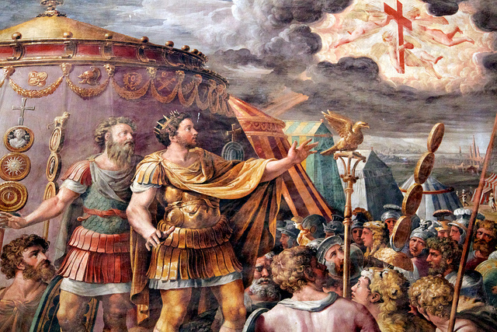
Constantine
Battle at Milvian Bridge
Claims to have seen a cross in the sky formed by the clouds
Considered it an omen from God
Promised he would become a Christian if he was victorious in battle
Notes:
After Diocletian’s death, there were rivalries in Rome over who would be Caesar. It came down to a battle between Constantine and his bro-in-law Maxentius at the Battle of Milvian Bridge. Eusebius records that the night before the battle, Constantine had a vision of a cross in the sky formed by the clouds. Considering it an omen from God, he vowed to become a Christian if he were victorious. Constantine won a decisive victory over Maxentius which gave him undisputed control over the western half of the Roman Empire.

Slide 5
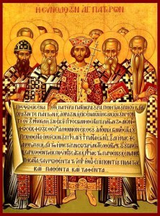
Constantine
Edict of Milan
Absolute freedom of religion
Christianity on equal footing with all other religions
Christians meeting places and property were restored
Notes:
In Feb 313AD, Constantine issues the Edict of Milan, which was an edict of toleration. Contrary to popular belief, this was not an edict merely granting toleration to Christians. It in fact granted toleration to all religions. While Constantine claimed to convert to Christianity, evidence points this to being an act to align himself with the Christian God whom he saw as the strongest deity. In fact, he was not even baptized until the day before his death. Constantine at that time was more concerned about social stability and the protection of the empire from the wrath of the Christian God than he was for justice or care for the Christians. The Edict of Milan is more indicative of the Roman culture’s obsession with seeking the gods intervention than of Constantine religious beliefs. As a result of the edict, Christians who lost their property and meeting houses under the previous persecutions had them restored.

Slide 6
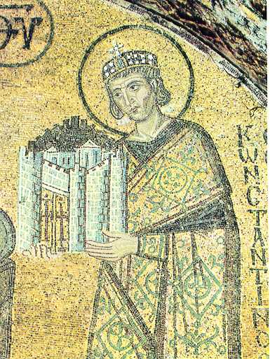
Constantine
Christianity favored
Christian “clergy” relieved of certain civic duties and elevated to positions of power/influence
Christian “clergy” exempted from paying taxes
Grants of money given to churches and magnificent church buildings erected
Jews forbidden from owning Christian slaves or circumcising them
Notes:
Though the Edict of Milan placed all religions on equal footing, Constantine preferred Christianity and therefore favored it above other religions. He therefore used his power and authority as emperor to grant privileges to Christians, especially those in positions of leadership. He relieved “clergy” from certain civic duties along with elevating them to positions in the aristocracy. Christian “clergy” were exempt from paying taxes and money was given by the government to build church buildings. Constantine also made new laws pertaining to Jews in that they were forbidden to own Christian slaves or to circumcise their slaves.

Slide 7
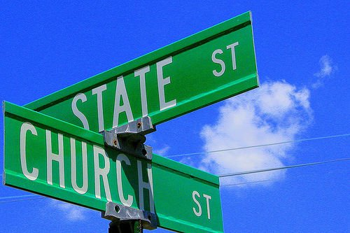
Constantine
Relationship of church and state compromised
Constantine leveraged the freedom/privileges granted to the church by demanding a stay so in its affairs
Examples:
Day of the Sun became law
Arbitrated Council of Arles
Arbitrated Council of Nicaea
Nicene Creed became law
Notes:
Because Constantine granted so many favors and privileges to the church and because he was emperor, he believed this granted him special privilege in church affairs. This is the first example in history where the relationship of the church and state becomes compromised. While the church influenced Constantine, he also influenced the church in the following ways:
First, Constantine demanded that Christians unite in worship together on the “venerable day of the sun” (which was influenced by his adoration for sun god worship). He also made this a day of rest. Christians were already meeting on the first day of the week so the decree was coincidental. Yet Constantine made it law and therefore showed he was still not detached from idolatry.
Secondly, one of the primary influences of Constantine was the calling of church councils to settle disputes and pass ordinances. He set himself up as arbitrator of these councils. He did this not because he was interested in truth/doctrine but because he wanted there to be peace in the empire.
The Council of Arles was called by Constantine to deal with the issue of Donatism. Donatists were excommunicated from the church as a result of the counsel. Several ordinances were also passed at this counsel.
The council of Nicaea was called in AD 325 to decide the nature of Christ and His relationship with the Father. Once the council decided that Christ was eternal and shared substance with the Father, the first creed was written to assert this fact and was to be accepted by all churches universal.

Slide 8
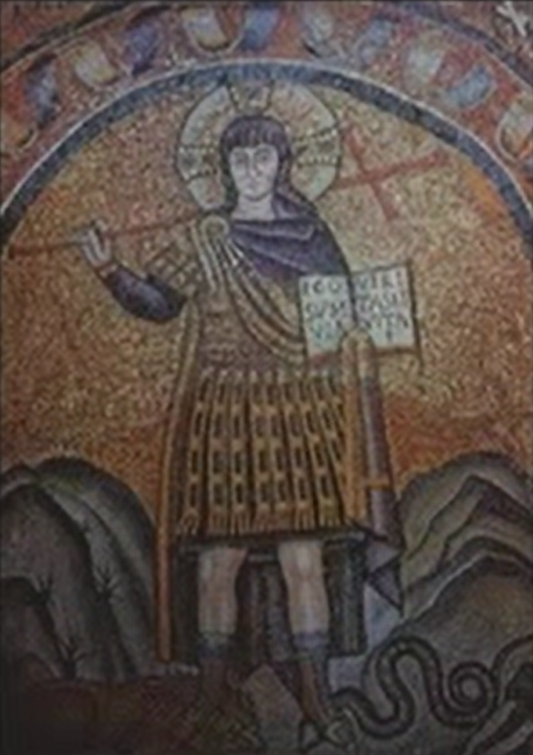
Constantine
Paganism invades the church
Christianity became a stepping stone to political, military, and social promotion
Heathens flooded the church desiring to be “Christian” and bringing heathen ideas
Constantine transformed pagan temples into church buildings
Constantine himself only Christian outwardly; personal life left much to be desired
Notes:
Since Christianity was now the favored religion of the Emperor, the Christian name became a stepping stone to political, military, and social promotion within the empire. Pagans and heathens of all backgrounds flooded the church desiring to be “Christian” without any real conversion taking place. With these unconverted heathens came pagan traditions and superstitions that were reinvented to look “Christian”. Because Christians were so glad the persecution was over, they then gave in to these changes for the sake of “peace”. The church took a giant leap in becoming corrupted and distant from the church that Jesus built. Constantine himself was only a Christian outwardly. He had several young men executed who might have laid claim to his throne. The church has now compromised to a place it would be difficult to come back from.
Constantine’s dream transformed the Jesus of the New Testament, the One who said “Love your enemies,” and “My Kingdom is not of this world. If it were, my followers would fight;” the One who refused to be made King by the people; the One who told Peter to put away his sword and warned that “All who take up the sword will die by the sword” and then healed the servant’s ear; the One who rebuked James and John for wanting to call down fire on the Samaritans; the One who commanded non-resistance to evil, turning the other cheek, and a host of other non-violent love-centered admonitions toward enemies and adversaries; the One whose followers understood and obeyed these commands to the letter for almost three centuries — in short, Constantine’s dream took this Jesus of the New Testament and transformed Him into a violent, military god of war, and made Him the official god and supreme king of the Roman Empire.

Slide 9
Action
Reaction
Christians were so glad persecution had ended, they willingly compromised for the sake of “peace”
Notes:
This leads us to our first “action/reaction” slide. Christians were tired of “fighting” for righteousness and justice - the persecution had worn them down and they had lost their endurance. And now a king has come offering peace if you’ll allow him certain rights and privileges in the church. Therefore sin was ignored, false doctrine was tolerated, and individuals were allowed fellowship who were not true Christian converts. These individuals brought their idolatrous superstitions into worship. The leavening effect completely changed the nature of the church within just a couple hundred years as doctrines finding their foundation in idolatry flooded the church.

Slide 10
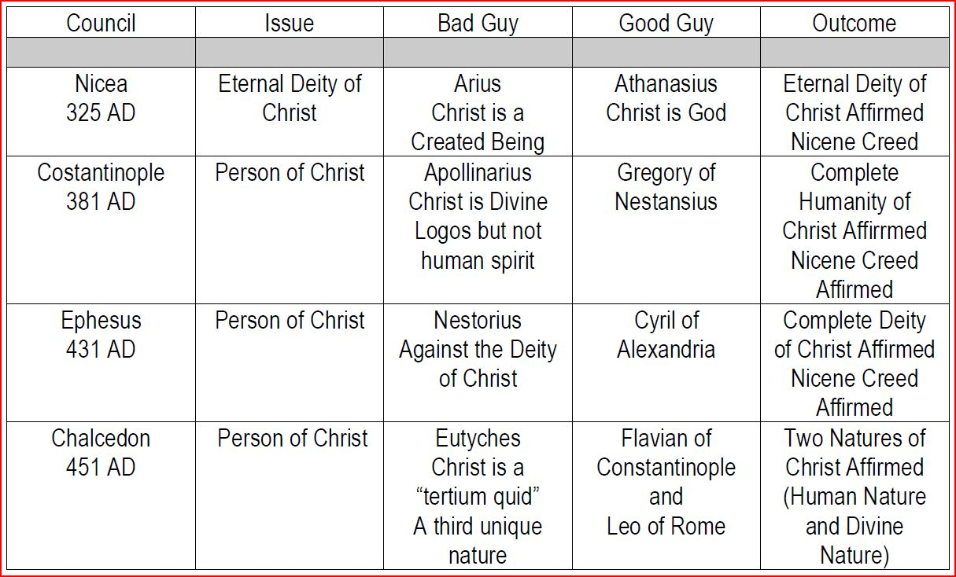
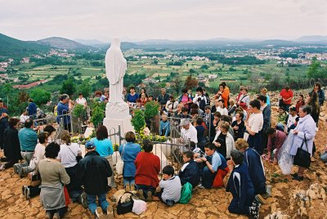
Doctrines Introduced
Church Councils (325AD)
Why?
Government (Constantine) wanted say so in church affairs
Result:
Authority of scripture replaced w/creeds
Mariolatry (379AD)
Why?
Pagan practice stemming from the natural tendency of the human heart to worship Femininity (Jer 44 )
Result:
Not only is Mary worshipped, she is placed as a intercessor between mankind and Jesus Christ
Notes:
Church Councils – The beginning of church councils was such a monumental change to how the church got its authority, historians typically divide church history into “Ante Nicene” and “Post-Nicene” to mark the period before and after the Council of Nicaea. The entire purpose of church councils (besides maintaining peace within the church and therefore the empire) was to solidify what churches should practice and teach. Bishops were typically present at these councils and tasked with enforcing the verdicts that resulted. Creeds were written that Christians within local churches were expected to abide by.
Mariolatry – It was very common for pagan religions to have a mother goddess to whom sacrifices were offered. Jer 44:15-19 informs us of this problem amongst the people of Judah in Jeremiah’s day who were determined to offer their sacrifices to this false god despite Jeremiah’s urging not to do so. Interestingly, when the doctrine was first suggested it was condemned as heresy but as the years went on it gradually began to be accepted in order to pacify the heathens who had infiltrated the church. In 451 at the Council of Chalcedon, it was established that Mary would be called the Mother of God putting her equal if not superior to God the Father and the Lord Jesus Christ. Though the Catholic church denies she is superior to God, they treat her as such by how she is portrayed in cathedrals all over the world.

Slide 11
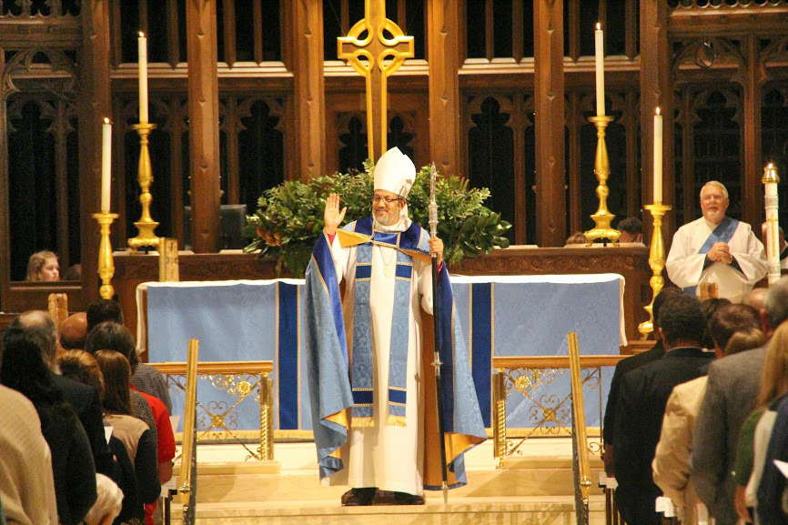
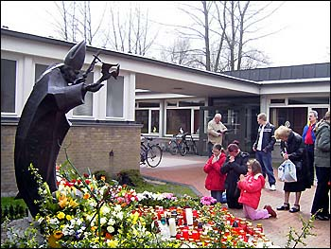
Doctrines Introduced
Mass (394AD)
Why?
Idolatrous ritualism and clergy/laity distinction
Result:
Took away the power of the word to convert people
Denied the right of people to think for themselves
Image Worship (405AD)
Why?
Image worship finds its root in all forms of idolatry going as far back as the early days of the OT (Ex 32)
Result:
Images of Jesus, Saints, The Pope, etc. kneeled before and worshipped
Notes:
Mass – The mass is a series of rituals centered around the communion supper. According to the New Saint Joseph Baltimore Catechism, vol 2, question 357, “The mass is the sacrifice of the new law in which Christ, through the Ministry of the priest, offers himself to God in an unbloody manner under the appearances of bread and wine. The mass is the sacrifice of Christ offered in a sacramental manner…the reality is the same but the appearances differ.” During the ceremony of the Mass during the part of the liturgy known as the consecration, Catholics believe the priest changes the bread and wine into Christ's body and blood. For over 1000 years, the Roman Catholic church conducted their mass services entirely in the Latin language even when no one sitting in the pews understood the Latin language. Most Roman Catholics who have sat through such a Latin Mass service have wondered what is going on. It was not until 1965 AD that the Pope finally understood 1 Cor 14:19 and allowed masses to conducted in the same vernacular language of the local people.
Image Worship - The lack of a physical description of Christ has not stopped the Catholic Church from depicting Him. Throughout Catholic churches, institutions, convents, monasteries, and every other Catholic-affiliated building and shrine, there are paintings of God the Father, Jesus, the Holy Spirit, Mary, Joseph, and a myriad of canonized saints. There are statues in abundance; there are relics, such as bone fragments, said to have belonged to certain saints. Some shrines even contain pieces of wood purported to be part of Jesus’ cross. All of these things are held to be sacred objects worthy of high regard. The idolatry is rampant and fairly obvious to non-Catholics, yet Catholics do not believe they are committing idolatry. The Catholic Church long ago began making allowances for the idolatrous use of images by the way they reference the 10 Commandments. In the Catholic catechism and in most official Catholic documents, the first and second commandments are combined and then summarized with “I am the Lord your God. You shall not have other gods beside Me.” Suspiciously absent is what comprises the second commandment in the Protestant numbering of the Ten Commandments: “You shall not make any graven images.” While it is understandable for “you shall not make any graven images” to be considered an aspect of “you shall not have other gods beside me,” based on the history of idolatry involving graven images throughout biblical and extra-biblical history, it seems unwise to not include “you shall not make any graven images” in every listing of the Ten Commandments. The omission seems especially suspicious in light of the fact that the Roman Catholic Church has long been accused of the idolatrous use of graven images.

Slide 12
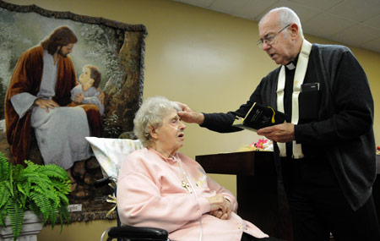
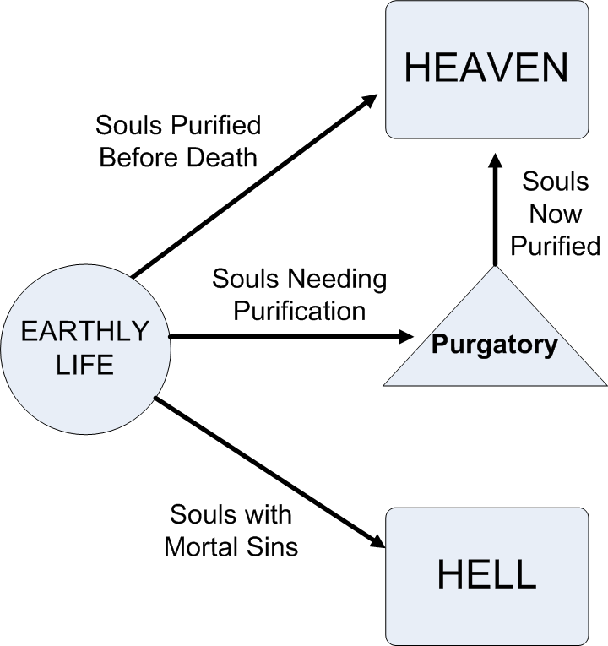
Doctrines Introduced
Extreme Unction (588AD)
How Began?
Babylonian God “Nimrod” – “Lord of Oil”
Rome’s statue of Saturn (Nimrod) was filled with oil
Oil used by Pagans to prepare idol worshipers to meet their god in a vision and prepare them for death
Result: Used in the church to prepare those dying to meet God
Purgatory (606AD)
How Began?
Molech (Lev 18:21) - infant sacrifice by burning
Tammuz (Ezek 8:14) - “Tam” means “perfect”; “Muz” means “by burning”
Taught by Buddhism, Stoicism, and Muslim fathers
Result:
Discouraged holiness & encouraged sin
Notes:
Extreme Unction - The practice of extreme unction, when death is visibly at the very door, originated in Babylon as an anointing for the last journey into the mysteries. It goes as far back as the god of Babylon called Nimrod which means, “Lord of Oil”. It transferred through the years to the Roman god Saturn whose statue was filled with oil and was used by pagans to prepare idol worshippers to meet their god in a vision or to prepare them for their death. Catholics picked up this heathen practice at the end of the 6th century and introduced it as a sacrament to prepare those dying to meet their God.
Purgatory - The first real evidence of this doctrine in Catholicism occurred when Pope Gregory the Great claimed the existence of a third state, one different than Heaven and Hell. The idea was not officially adopted into Catholic dogma until the Council of Florence in 1459. From that point on, the Catholic church has freely taught the concept of purgatory as a purification place for souls. However, this doctrine was in effect long before the time of Gregory the Great. In the 4th Century B.C., Plato spoke of certain teachers of his day who believed in purgatory. Buddhism, Stoicism, and the Moslim fathers also believed in a place of purification where souls must go before they can attain Heaven. These beliefs have their root in Babylon. The most probable source is that of the worship of Molech. Many pagan nations felt that fire was necessary to cleanse from sin. This is probably because they were worshippers of the sun god, and his power on earth was represented by fire. This was evidenced in the worship of Molech, as young infants were made human sacrifices and burned in the arms of the idol. God made special mention of Molech and forbid his worship in II Kings 23:10 and Leviticus 18:21. In fact, Molech is simply another name for Nimrod. The name Tammuz sheds light on this as well. ''Tam" means "perfect"; "Muz" means "by burning". (15) This shows that the idea of purification by fire has its roots in the Babylonian worship of Nimrod.

Slide 13
Action
Reaction
In response to immorality in the church, Monasticism developed
Notes:
In the 4th century when internal decay was affecting the Roman Empire and the church, certain men would withdraw themselves from society and live in separate isolated places to become “holy” and devote themselves to prayer, contemplation, and ascetism. This movement was called Monasticism. The causes of such a movement were the following:
Influence of Gnostic and Neoplatonic movement where the flesh was thought of as evil and therefore needed to be “crucified” through spiritual meditation and ascetic acts.
Psychological. When problems arise in society or in life, sometimes it is easier to retreat than to confront the problem head on. Monasticism became a means of escape for such individuals.
Increasing moral degradation in the church caused some to be pessimistic about any hope of true spiritual reform. In some ways, monasticism was a living criticism of the time.

Slide 14
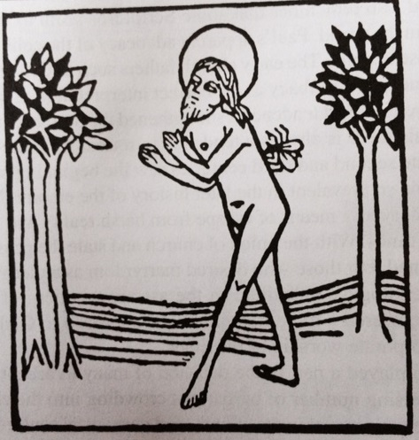
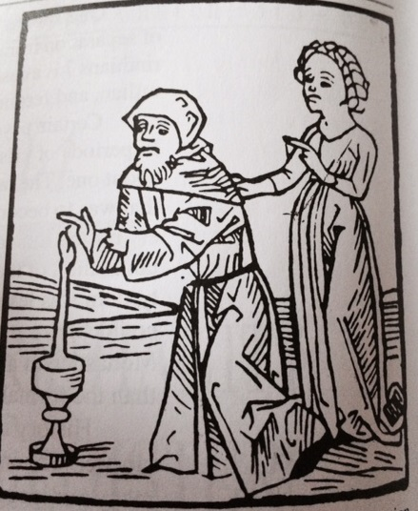
Monasticism
Advantages
Scripture was preserved after barbarians sacked Rome
Monasteries became a refuge for the needy
Monks became the missionaries of the medieval world
Disadvantages
Church was robbed of moral individuals
Celibate lifestyle robbed them of marriage and children
Monasticism pandered to spiritual pride
Woodcut depicting Macarius, who was so penitent for having killed a mosquito that he lived for 6 months in a swamp, allowing insects to sting him.
Woodcut depicting a monk burning away the remaining finger and thumb of his right hand because he considered women the source of temptation and sin. All that remains of his left hand is a stump.
Notes:
Advantages
Monasteries helped keep scholarship alive during the dark ages between 500 and 1000AD when urban life was disrupted by barbarian invasion who took over the Empire. Monks busied themselves copying manuscripts and scripture. Monastery schools provided low-level education for any who desired to learn
When someone needed help, they could always find refuge in a monastery where monks would tenderly care for them. They provided hospital care, food, shelter, or simply as an escape when tiring of the world.
Monks became the missionaries of the medieval church. Numerous barbarian tribes learned of Christianity from monks (England, Scotland, etc.) However, they did not explain the implications to those who were baptized and so many false conversions took place as people were baptized simply because their ruler was.
Disadvantages
The church was robbed of some of the most moral of Christians when it needed them the most. Rather than being a light to the world and loving their neighbor as themselves, they withdrew and could not have a positive influence on their brethren
Part of the ascetic lifestyle developed into celibacy where good men were robbed of the benefit of marriage as well as procreating. Since God intended marriage and parenthood to be a blessing and learning experience that models the church, these men could and would not experience it.
Monasticism was subtly veiled spiritual pride. They became proud of their ascetic acts. Eventually monasteries became wealthy due to community thrift and therefore ownership, laziness, avarice, and gluttony crept in.

Slide 15
Questions For Discussion Next Week
What are disadvantages of Christians withdrawing from society?
How can a desire for “peace” lead to compromise?
How should we respond to government interference in the church?
Notes:
Here are our questions for next week:
What are disadvantages of Christians withdrawing from society?
How can a desire for “peace” lead to compromise?
How should we respond to government interference in the church?

Slide 17
Notes:
As we study church history, we want to be careful to make sure we learn the practical applications to help us in our walk with God today. History contains more than just stories, but also action/reactions that are similar to the issues we encounter in the 21st century. Learning where early Christians succeeded and failed will help us solidify our faith.

Slide 18
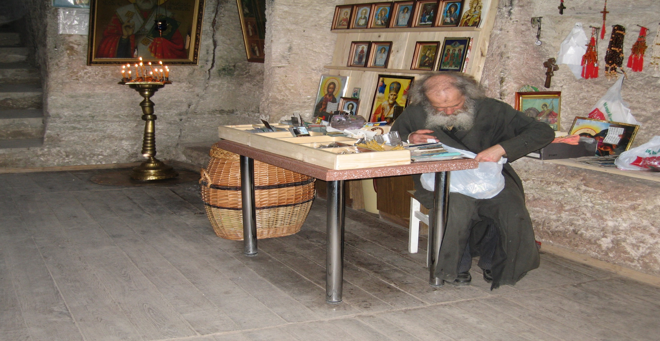
Practical Applications
1) What are disadvantages of Christians withdrawing from society?
Notes:
On the surface, Monasticism seemed like a noble cause by some devoted men who did not want the immorality coming in the church to contaminate them spiritually. However, there were notable disadvantages to men withdrawing themselves from society. Today, some Christians become frustrated by hypocrisy to the degree that they evoke the term “Pharisee”, or they become disgruntled because a church doesn’t meet a certain expectation that they deem important. While they don’t necessarily withdraw themselves from society, some will seek out those who they deem “elite” like themselves. Why should we avoid this kind of mentality?

Slide 19
Practical Applications
1) What are disadvantages of Christians withdrawing from society?
We lose our ability to influence others
Matt 5:14-16 – “¹⁴You are the light of the world. A city set on a hill cannot be hidden; ¹⁵nor does anyone light a lamp and put it under a basket, but on the lampstand, and it gives light to all who are in the house. ¹⁶Let your light shine before men in such a way that they may see your good works, and glorify your Father who is in heaven.”
Fosters Spiritual Pride
Gal 6:3 – “For if anyone thinks he is something when he is nothing, he deceives himself.”
Hinders our personal growth
Eph 4:1-3 – “¹Therefore I, the prisoner of the Lord, implore you to walk in a manner worthy of the calling with which you have been called, ²with all humility and gentleness, with patience, showing tolerance for one another in love, ³being diligent to preserve the unity of the Spirit in the bond of peace.”
Notes:
If we’re concerned for those in the world or in my local church, we should strive diligently to help them see the truth. Our job as Christians is not to ostracize ourselves from others, but to be lights of the world and salts of the earth. The second greatest commandment is to love our neighbor as ourselves and we can only do that by spending time with others, teaching others, bearing burdens, etc. Salt can only preserve that which is perishing by coming in contact with it.
When a person wants to withdraw themselves because they believe they are too righteous, this should cause us to be greatly concerned for that person. “All have sinned and fallen short of the glory of God” (Rom 3:23) and while we are so focused on others’ sins, we need to be acutely aware of our own. This allows us to show mercy and compassion and forbearance towards others’ faults. Beware of the trap of thinking there is more to us spiritually than in reality. We are far worse than we know but loved by God greater than we can imagine.
Building relationships with those who are lost and those brethren who have weaknesses allow us to develop characteristics and qualities incumbent of disciples. No one is born with the ability to be patient, forgiving, kind, etc. These are commands because we have to practice them despite our feelings at the moment. Disconnecting ourselves from others robs us of the “practice” we need to successfully develop these qualities.

Slide 20
Practical Applications
2) How can a desire for “peace” lead to compromise?
Notes:
Christians in the fourth century were so thankful the persecution was over that they desired to prolong the peace as long as possible. In doing so, they allowed the emperor to meddle in the affairs of local churches and allowed pagans to become members w/o truly being converted. In reality, their desire for “peace” compromised the integrity of the gospel. Jer 6:14-15 describes for us a situation in Jerusalem where false prophets were preaching a superficial “peace” when there in essence was no peace. They had forgotten how to blush. Today, churches can place a desire for “peace” above the integrity of the Lord’s church and the purity of the gospel. How does this happen?

Slide 21
Practical Applications
2) How can a desire for “peace” lead to compromise?
When we’ve given up fighting
Jude 1:3 – “Beloved, while I was making every effort to write you about our common salvation, I felt the necessity to write to you appealing that you contend earnestly for the faith which was once for all handed down to the saints.”
1 Tim 6:12 – “Fight the good fight of faith;”
When we become people-pleasers
Jer 6:13b-15 – “…and from the prophet even to the priest everyone deals falsely. ¹⁴They have healed the brokenness of My people superficially, saying, ‘Peace, peace,’ but there is no peace. ¹⁵Were they ashamed because of the abomination they have done? They were not even ashamed at all; they did not even know how to blush. Therefore they shall fall among those who fall; at the time that I punish them, they shall be cast down,” says the Lord.
Luke 6:26 – “Woe to you when all men speak well of you, for their fathers used to treat the false prophets in the same way.”
When we become obsessed with numbers
Matt 7:13-14 – “¹³Enter through the narrow gate; for the gate is wide and the way is broad that leads to destruction, and there are many who enter through it. ¹⁴For the gate is small and the way is narrow that leads to life, and there are few who find it.”
John 6:66-68 – “⁶⁶As a result of this many of His disciples withdrew and were not walking with Him anymore. ⁶⁷So Jesus said to the twelve, ‘You do not want to go away also, do you?’ ⁶⁸Simon Peter answered Him, ‘Lord, to whom shall we go? You have words of eternal life.’
Notes:
Some desire peace simply because they are tired of fighting the good fight. God commands us to contend earnestly for the faith and to fight the good fight but many brethren are content to just sit on their hands while immorality in a church worsens and rebellion is allowed to run amok. At one church I preached at, there was a very factious and seditious man upsetting the brethren. I had rebuked the man privately but he would not listen so I decided to take one or two witnesses with me. I asked an older man who I trusted to help me and he said, “Ryan, I’m retired”. When we’ve given up fighting for justice and righteousness, we’ve given up on fighting for the one who died for is. We must never mistake a desire for peace for cowardliness.
Our relationships within a local church will be tested when someone I am friends with or related to is going down a wrong path. Many today forsake their loyalty to Christ for the loyalty of another person and hence “look the other way”. “Faithful are the wounds of a friend” (Prov 27:6). We must never let our desire to please people and maintain relationships here on earth rob us of the one relationship that will matter the most on judgment day.
Many today are obsessed with increasing the membership of a church and/or increasing the bank roll. Hence, the church is looked at as a social club and not as the body of Christ where there standards are to be maintained and accountability to be enforced. Beware of those who constantly harp on numbers and want to eliminate “negative preaching” so more people will listen. Phrases like “I just want everybody that comes here to leave happy” and “People need to be uplifted not torn down” are clues that ulterior motives are in mind by some in the church.

Slide 22
Practical Applications
3)How should we respond to government interference in the church?
Notes:
The issue of church and state has been ongoing for hundreds of years and will continue to be until Jesus returns. In the first century, the church was described as that which was “upsetting the world” (Acts 17:6). Disciples were dragged before authorities simply for teaching (Acts 16:19). This tells us that if we’re preaching the truth today, government will inevitably get involved – for the “good” of the church or for the bad. How should we respond when those in the government take an active interest in the church?

Slide 23
Practical Applications
3) How should we respond to government interference in the church?
We must obey God rather than men
Acts 5:27-29 – “²⁷When they had brought them, they stood them before the Council. The high priest questioned them, ²⁸saying, ‘We gave you strict orders not to continue teaching in this name, and yet, you have filled Jerusalem with your teaching and intend to bring this man’s blood upon us.’ ²⁹But Peter and the apostles answered, ‘We must obey God rather than men.’”
Don’t allow federal/civic advantages to cloud biblical principle
Num 22:16-18 – “¹⁶They came to Balaam and said to him, ‘Thus says Balak the son of Zippor, “Let nothing, I beg you, hinder you from coming to me; ¹⁷for I will indeed honor you richly, and I will do whatever you say to me. Please come then, curse this people for me.”’ ¹⁸Balaam replied to the servants of Balak, ‘Though Balak were to give me his house full of silver and gold, I could not do anything, either small or great, contrary to the command of the Lord my God.’”
Notes:
When government is opposed to the church, we must be unyielding in our stand and preaching of the truth. The apostles faced this challenge when they were commanded by the Sanhedrin to stop speaking about Jesus. Their response of “we must obey God rather than men” should not just be in our mouths but in our heart. We must purpose for this principle to be in our heart so that when we are indeed challenged in the future we will not be caught off guard.
It may be that government becomes in favor of Christianity at some point in the future. With this favor may come certain privileges or requirements to bend to government edicts for the sake of lasting peace. We must be careful not to let advantages we receive as Christians in a particular nation cloud our judgment in how we are to live before Christ. It is easy to do this without even realizing it (Freedom, Rights, Equality, MDR, etc)

